Slide 1
Cromarty Youth Café Spectacular Summer Programme 2021

Slide 2
What Young People Thought about the Summer Programme
FANTASTIC
ACHIEVING
VIBRANT
FUN
FREE
LEARNING
ENERGETIC

Slide 3
Number:
547 Young people took part In the programme
39 Older People took part in the programme
At 57 different activities
Number of learning hours 1247
Every activity was full to capacity
586 Total Attendances

Slide 4
Funding for the Summer Programme
It wouldn’t have been possible to run The Summer Programme without the support of:
Cromarty Care Project
MFR Cash for Kids
Tesco Fare Share & Community Champion
Highland Council Ward 9 Budget
High Life Highland for Wanda’s Support in finding the funding, and supporting with the food side of the programme. Way over and above her own job.
The Middleton Trust for their support of the Assistant Youth Worker post and various other Resilience Projects.

Slide 5
Staff, Young Volunteers & Leaders
I would like to say a HUGE thank you to all the young volunteers / leaders who turned up everyday at activities to support.
Also HUGE thank you to John Munro for his invaluable support each day, Cycling to and from Culbokie Everyday for activities 600 Miles in Total
The biggest thank you goes to Wanda for her invaluable time, support and knowledge for supporting to run this programme.

Slide 6
Holiday Hunger
The term holiday hunger refers to children suffering from household food insecurity during the holiday period, meaning that they or their other family members are having to skip meals, or have to reduce the quantity or quality of food that they eat.
During every activity delivered in the summer programme every young people was offered a healthy nutritional meal and if there was left over some young people were offered to take a plate home.
Young leaders supported to make these meals
All the menu choices were decided by young people.

Slide 7
Outdoor Bakewell / Cookwell
Due to limiting the number of young people inside the hall we did cooking and baking outside.
The young people thought this was great and enjoyed cooking and baking outside.
Young people were learning how to read recipes, weighing out ingredients
Young people were helping to create lunch for every activity.
At each Bakewell sessions some of the recipes that were used were from older people in the community.

Slide 8
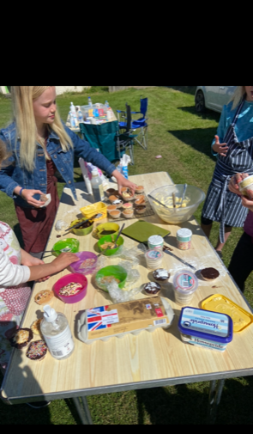

Slide 9
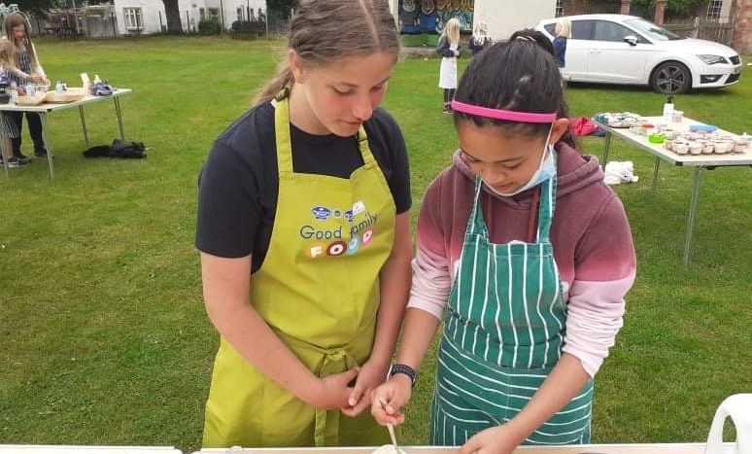
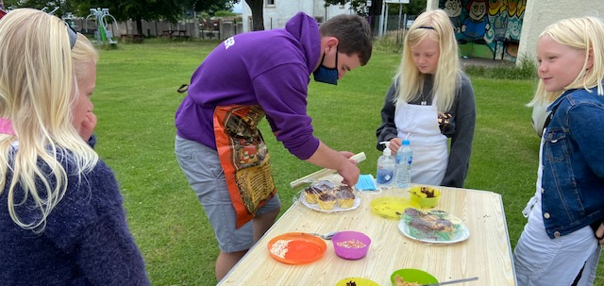
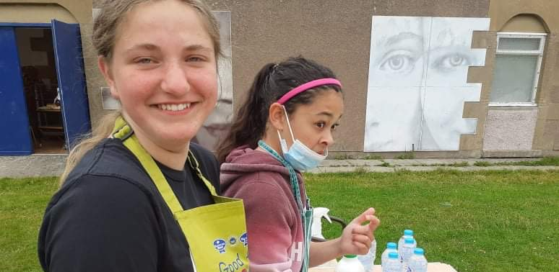
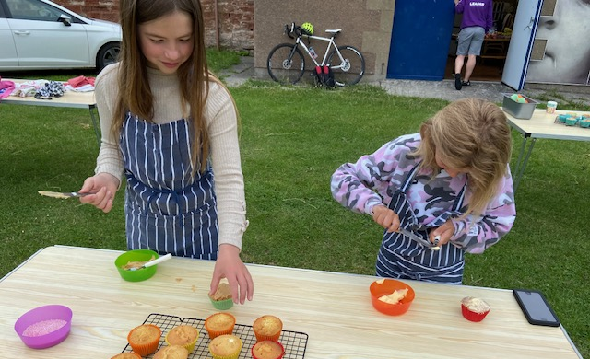
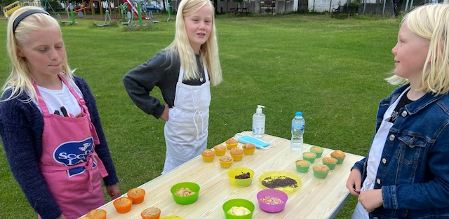

Slide 10
Fusion / Multi-Sports & Nerf Wars
These events were full of fun activities provided were:
Football, Dodgeball, Rounders, Nerf Gun Wars, Chaos Tig and many different team games.

Slide 11
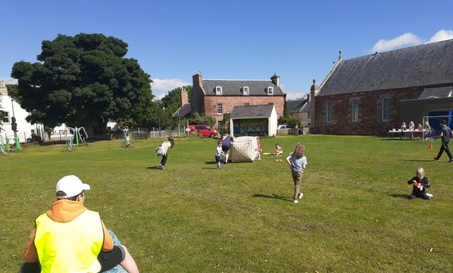
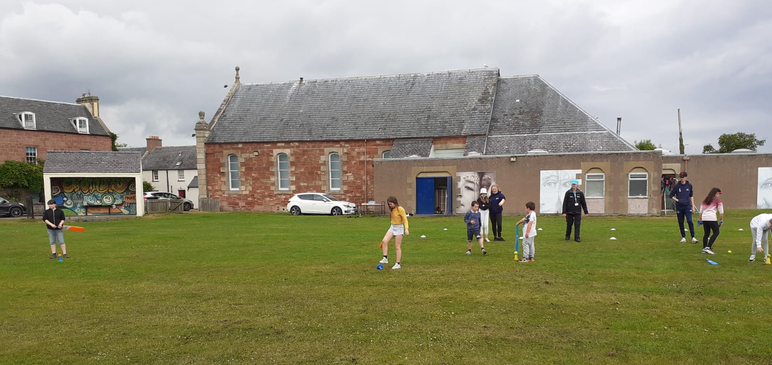
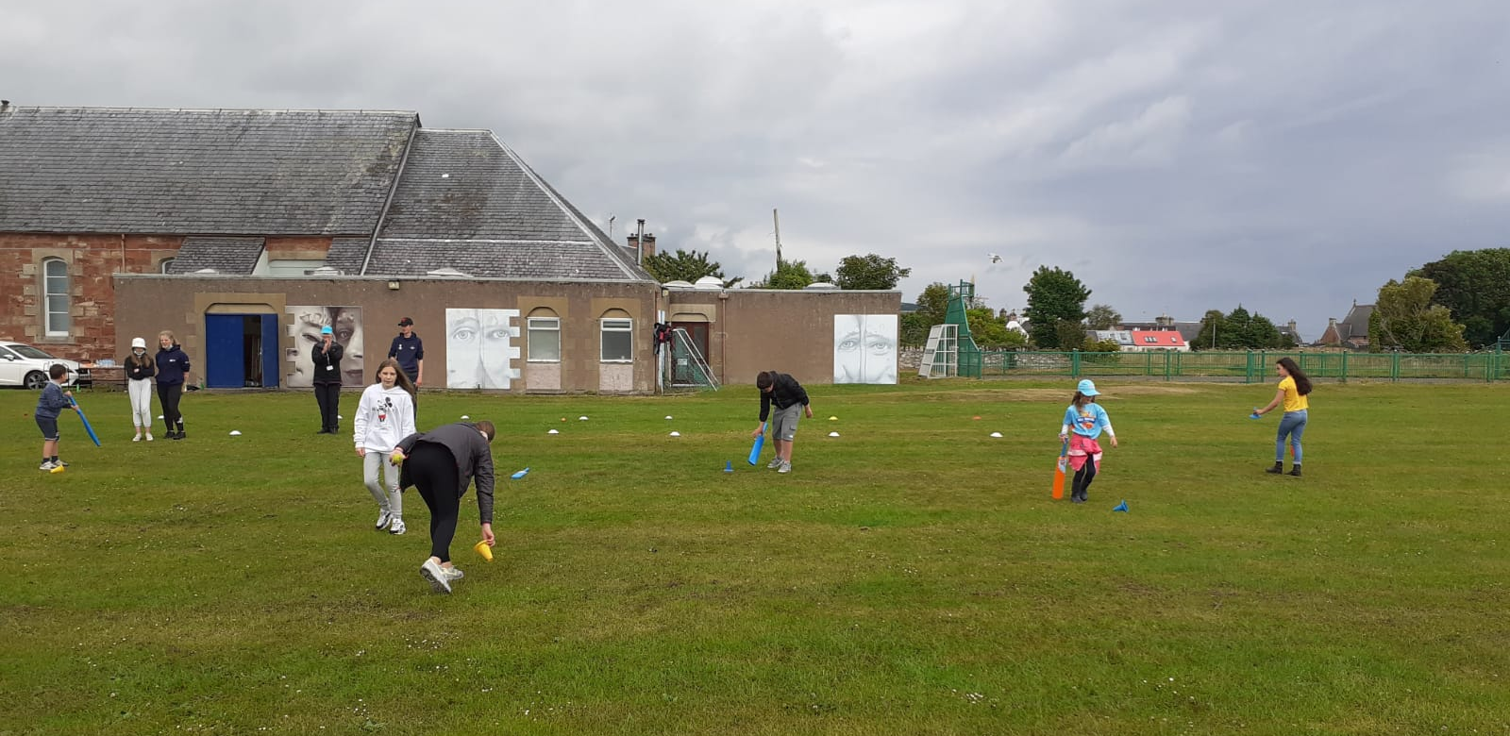
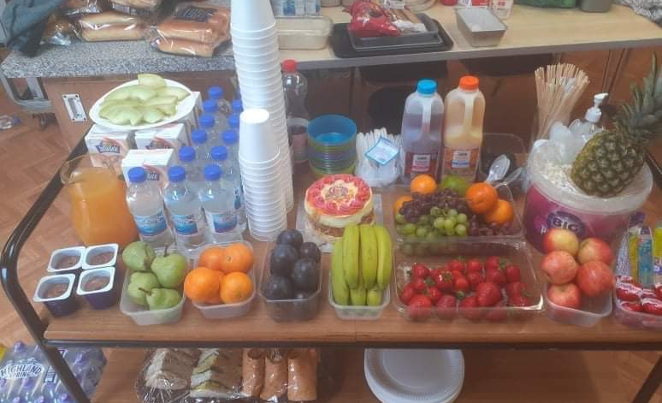
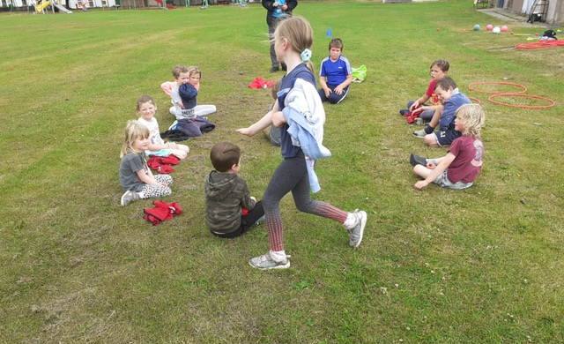
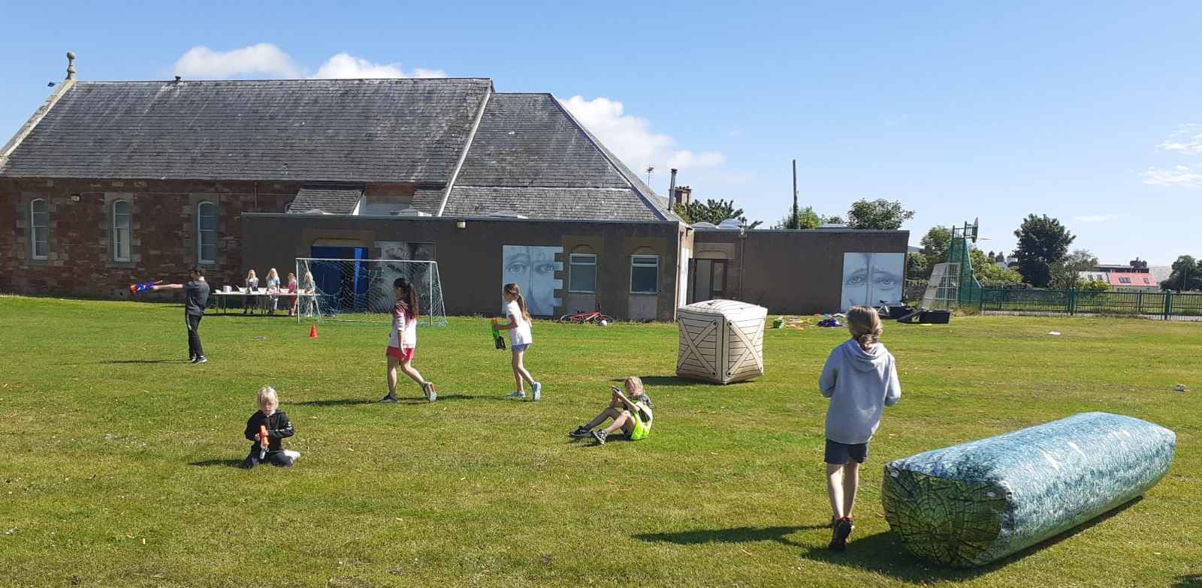

Slide 12
Mental Mountain Biking
3 sessions of mountain biking took place
2 sessions at Learnie
1 session at Craig Dunain Woods in Inverness
The young people that took part in these sessions really enjoyed taking part.
The session at Craig Dunain was thoroughly enjoyed as it was somewhere different

Slide 13
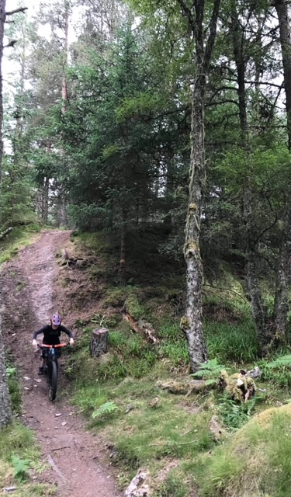
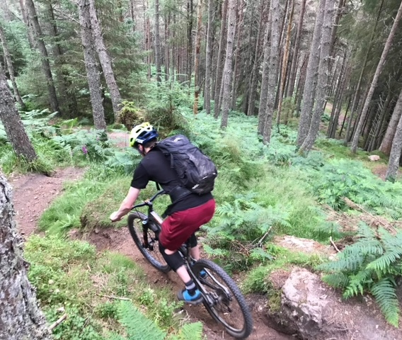
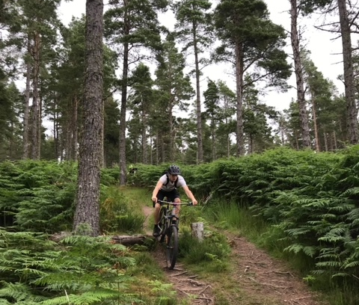

Slide 14
Football Coaching with Inverness Caley Thistle
This football session was well attended,
The young people learned lots of new skills, Passing , Dribbling , Target practice and mini Games.
Inverness Caley Thistle are coming back after the summer holiday to deliver football coaching by request of the young …….

Slide 15
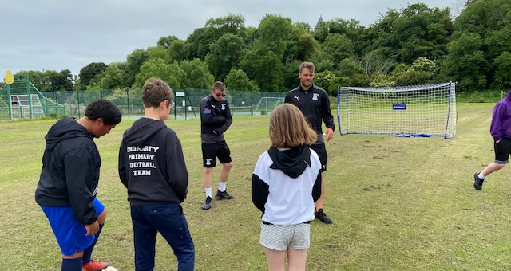
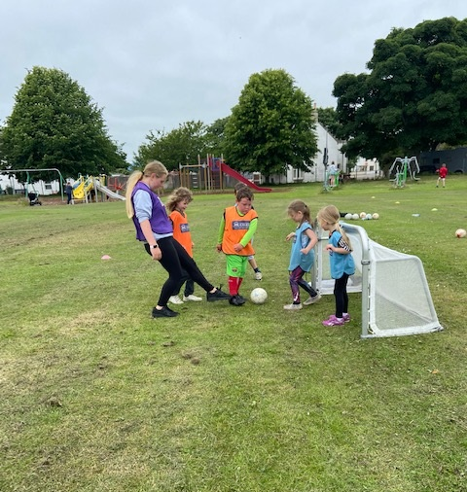
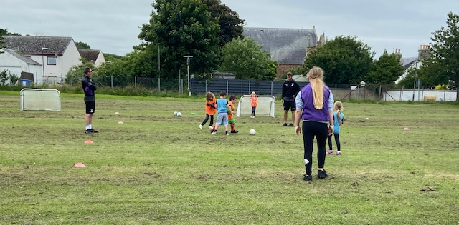

Slide 16
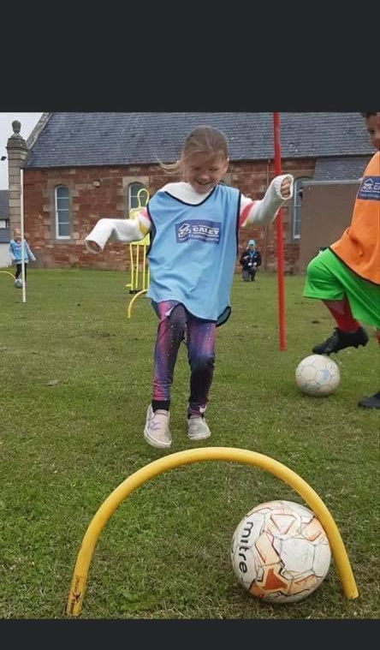
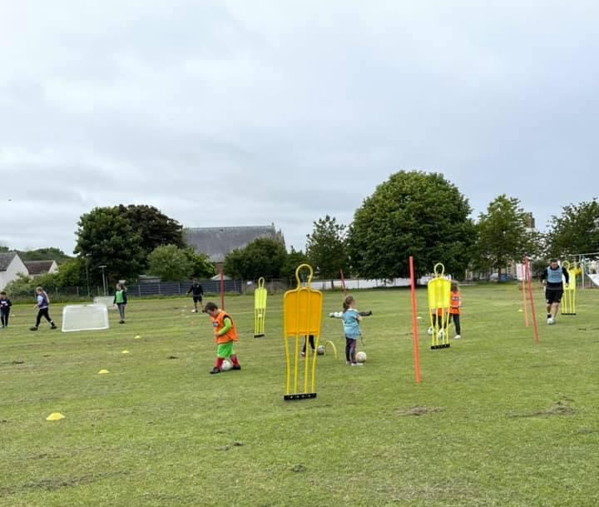
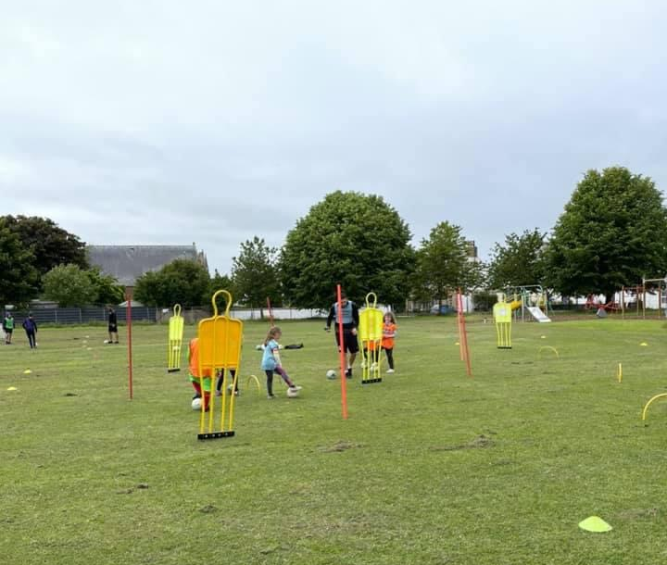

Slide 17
Intergenerational Events
Througtout the summer there was a range of intergenerational events held:
Cuppa and Craic – the young people and older people enjoyed a cuppa and talking to each other and sharing memories, taking part in fun quiz’s
Makaton – Hannah Williams from Highland Makaton came along and delivered an introduction to Makaton session with some younger and older people. The group learnt 20 new signs, this was support by 2 young people who have taken part in Level 2 Makaton . SINGING MAKATON
One older person knew some before
Each week the older people were given a buffet of different food that the young people had made,
Each week the older people took a plate of food home with them.
In the last week each older person received a Jar of Wanda’s homemade Jam, Tablet & a Tea Loaf

Slide 18
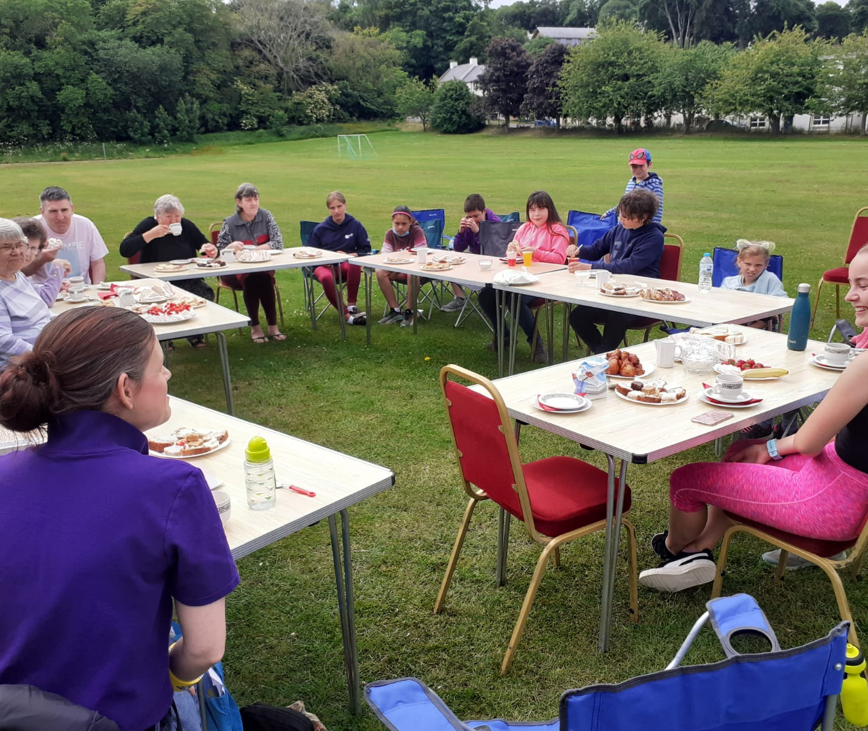
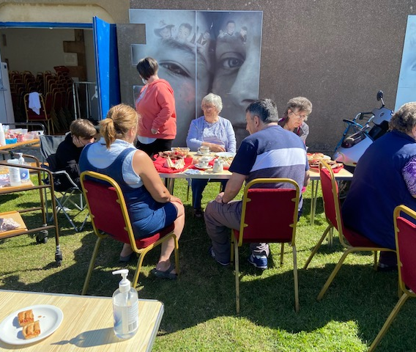
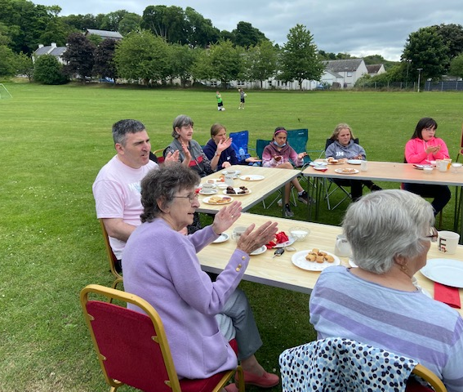
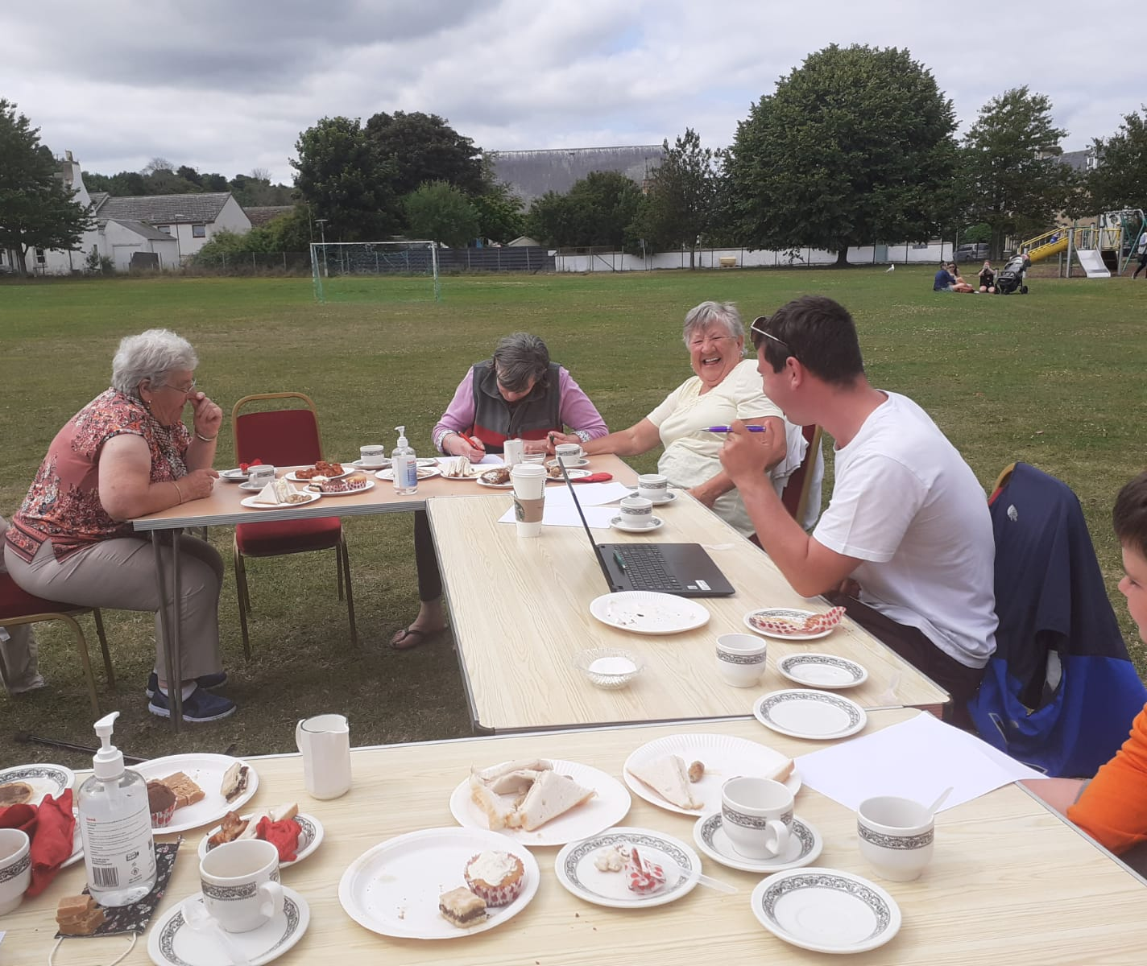

Slide 19
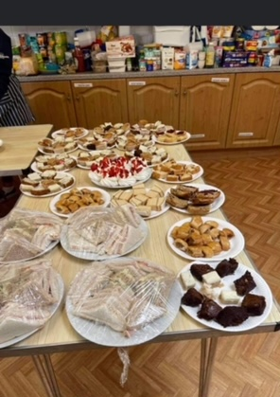
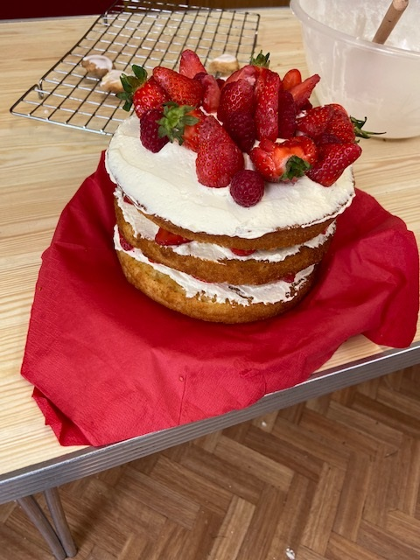
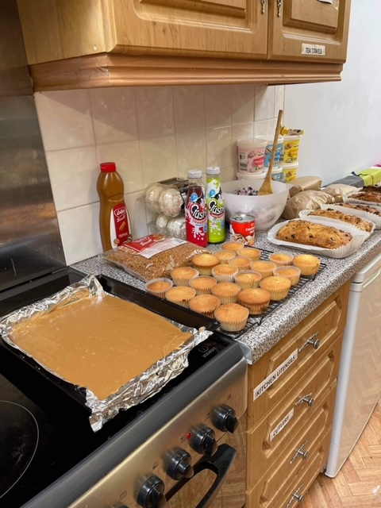
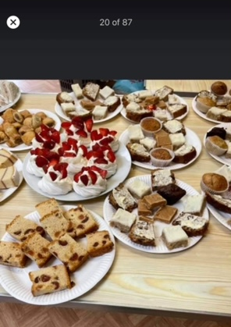
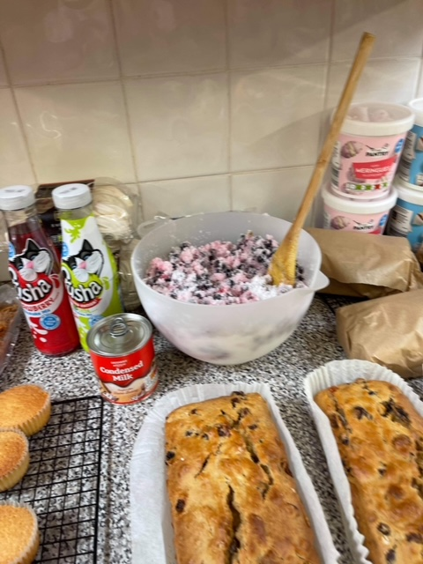
Intergenerational Refreshments

Slide 20
Activities at Wildwoodz
Archery – young people attended and learned about safety and enjoyed, some of the young people had never played archery before,
Dave from Wildwoodz explained how to use the bow and how to shoot the arrows,
Paintball – the group who attended were learning how to play the game as part of a team and to help team mates out, and to see which team would win,
These were the highest rated activity of the programme – 2 young people asked if they could book their spaces for next year.
Dave said “the behaviour from the group was impeccable”

Slide 21
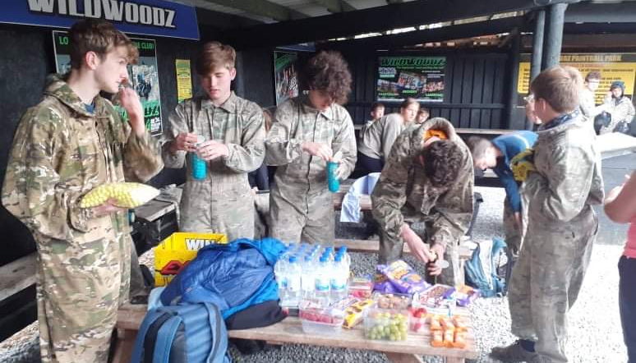
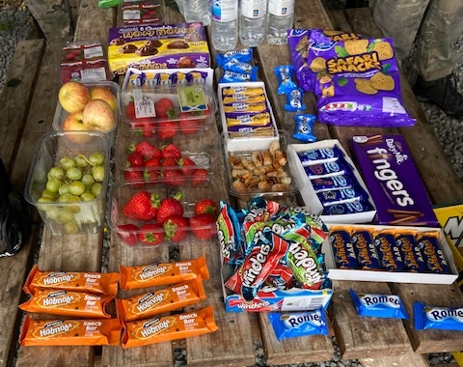
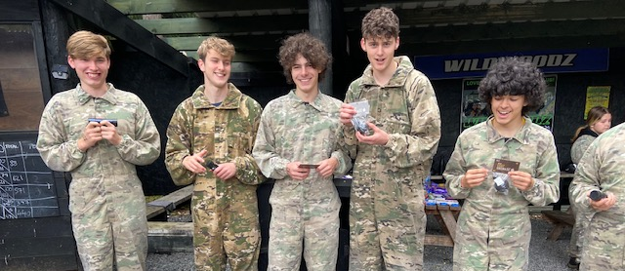
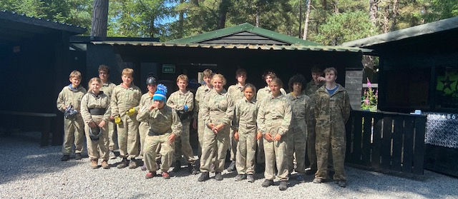
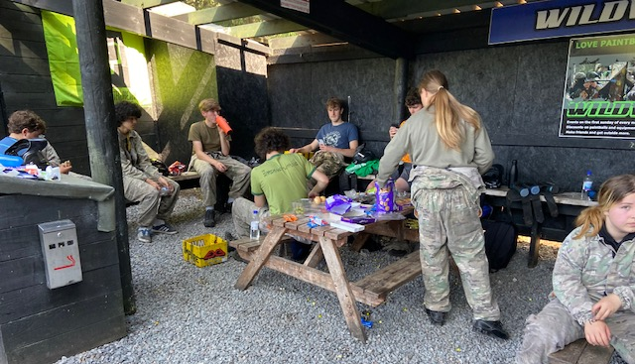

Slide 22
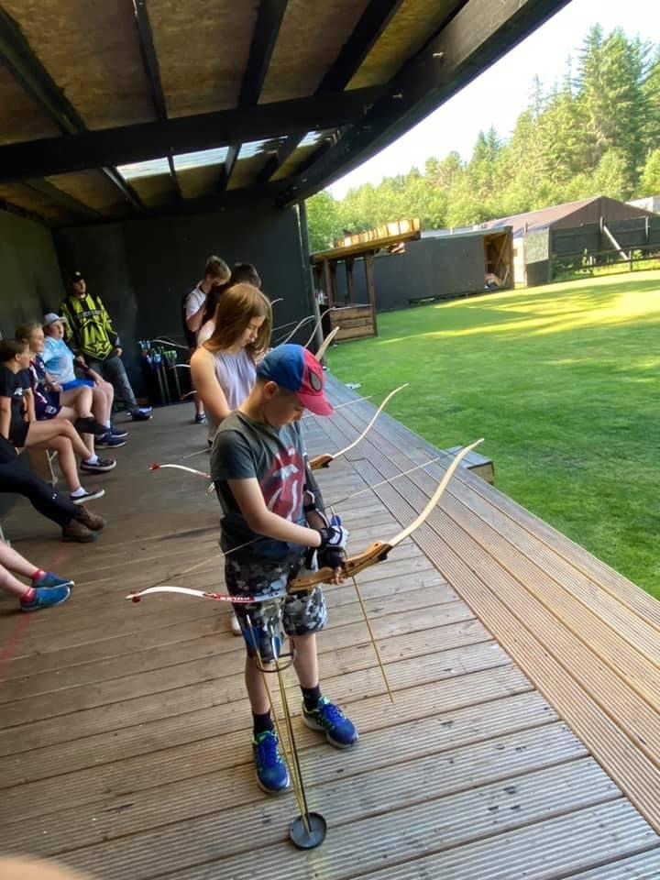
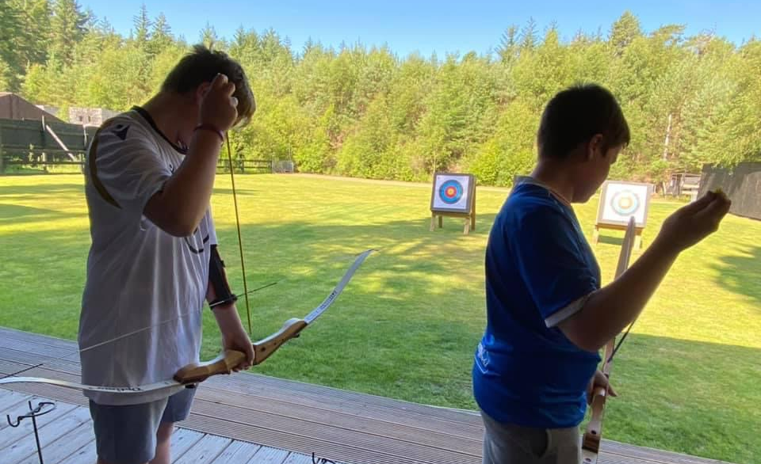
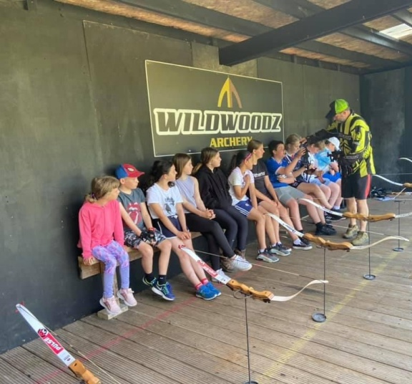
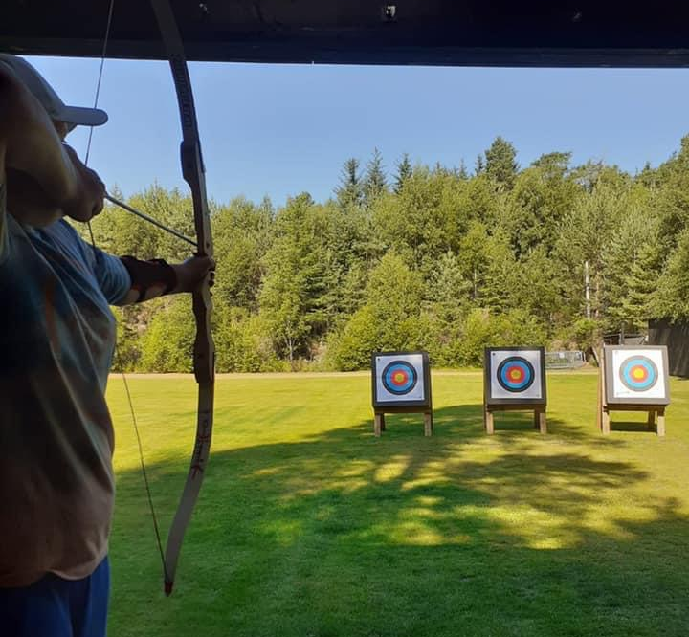
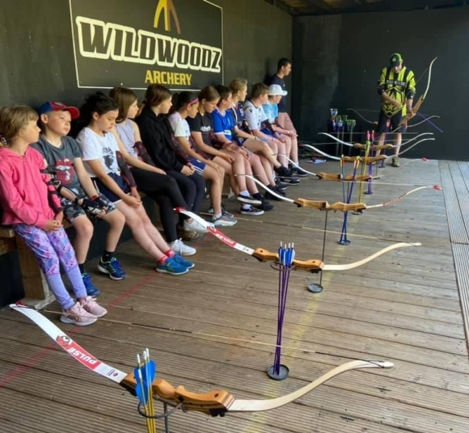

Slide 23
Rowing
Each week there was 7 different rows going out,
Young people were learning about technique’s timing and also were having fun and enjoyment,
A few of the rowers attended their first Regatta in Ullapool and won medals
Young rowers also attended a training event with Tim Down,
This training event was for all Youth Rowers focusing on timing and technique.

Slide 24
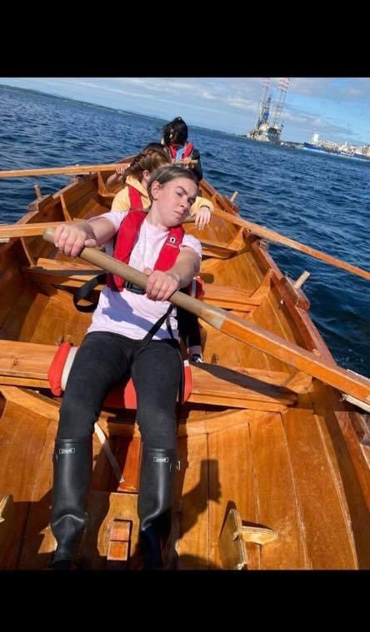
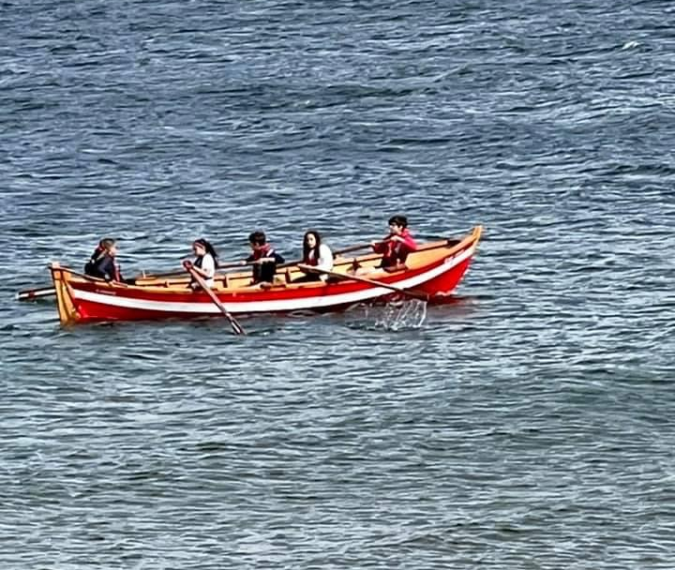
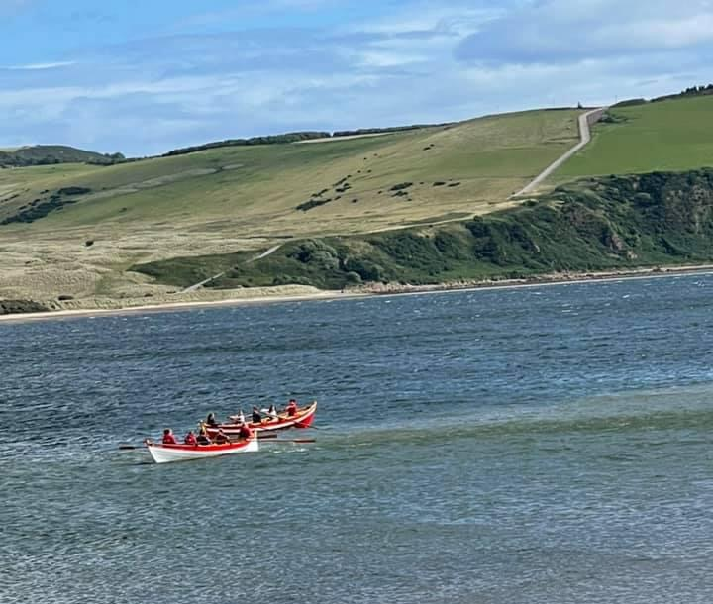

Slide 25
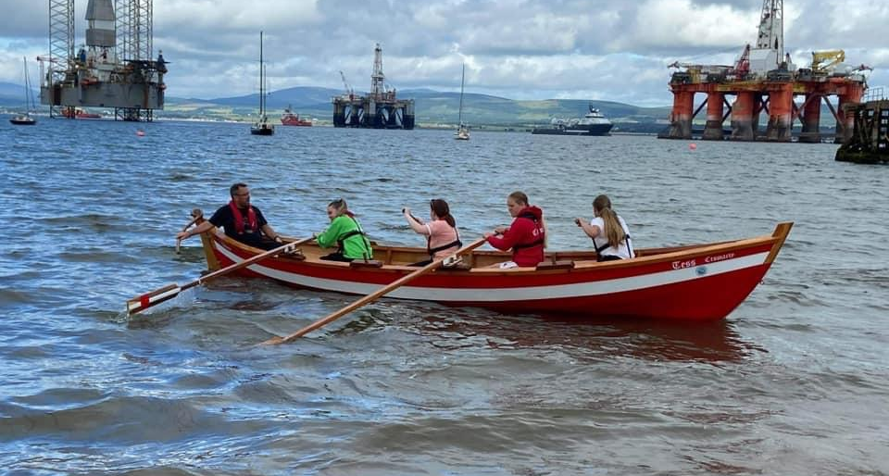

Slide 26
Meet Youth Work Team – Online and Walk & Talk
This session was planned for a quiz and scavenger hunt, but the young people who attended didn’t want to do a quiz,
They asked if they could update their Saltire Awards paperwork,
After we updated the young peoples Saltire Paperwork we took the young people for a walk,
We walked around Cromarty then part way up the 100 steps but before the walk we all had ice cream from The Ice Cream Van

Slide 27
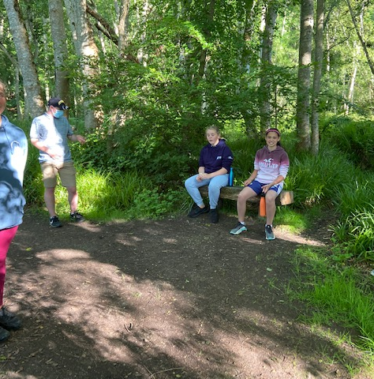
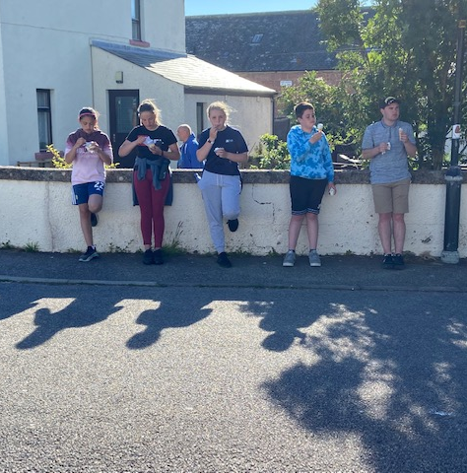

Slide 28
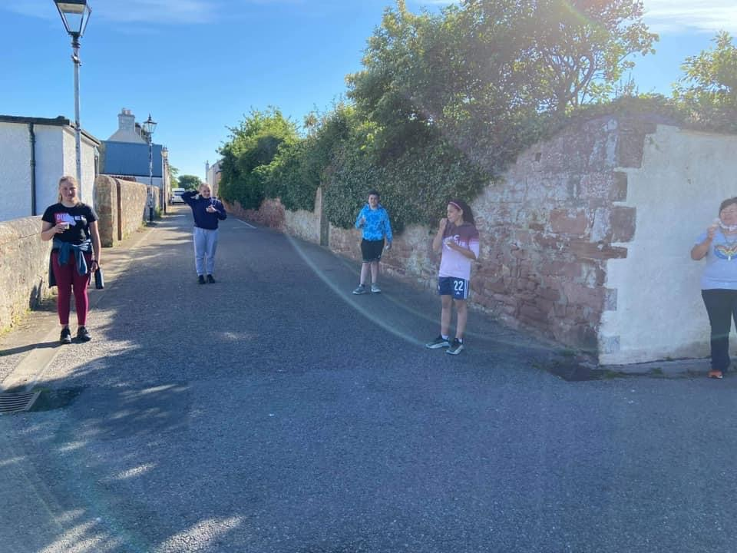
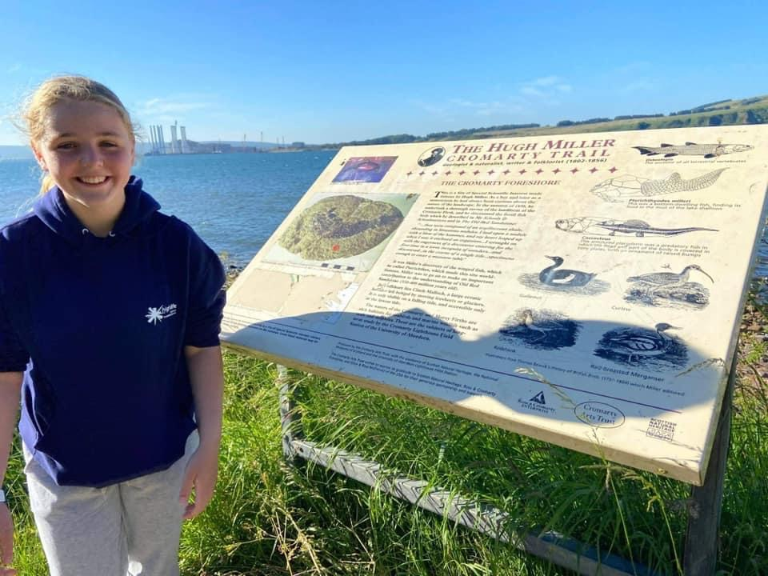

Slide 29
Tennis Coaching
Tennis Coaching took place every Saturday and then the last week of the programme
This was well attended
The young people who took part have improved so much in their tennis

Slide 30
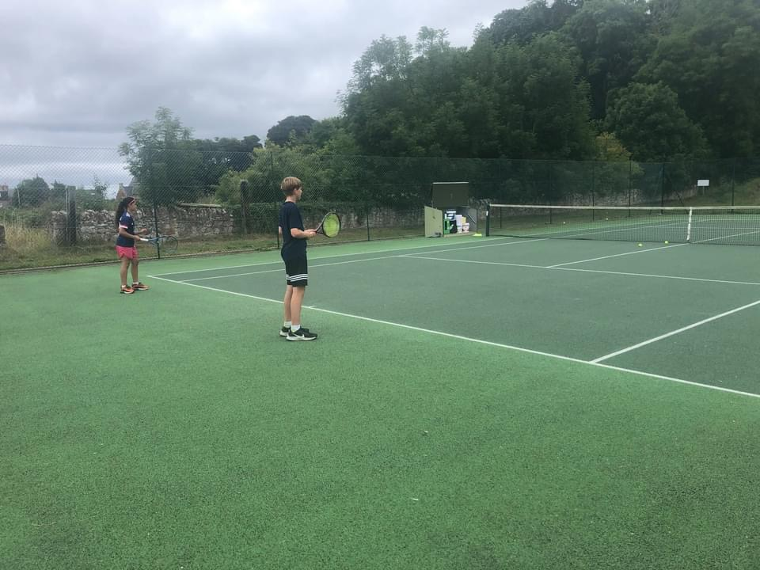
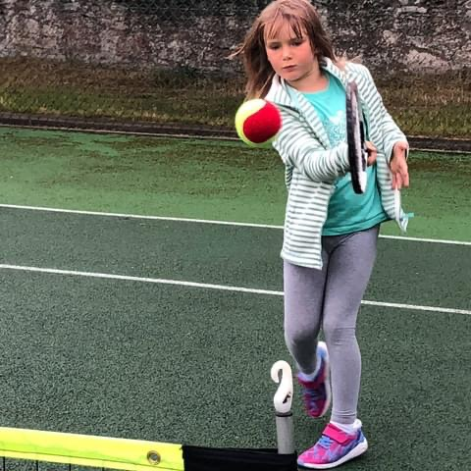

Slide 31
Crombledon 30th July 2021

Slide 32
Trip to Cromarty Cinema
We had a trip to Cromarty Cinema to watch the Film Cruella,
Everyone who attended really enjoyed watching the film and loved attending the cinema

Slide 33
Sit on Top Kayaking
Young people told us this activity was one of the Highlight of the programme.
Young people learnt how to use a Kayak, and they were also learning a bit about safety on the water.
One young person has now got his own Sit on Top Kayaking after taking part in the session

Slide 36
Cricket Taster Session
We had Finlay Saunders from North Highland Cricket Club come and delvier a taster session of Cricket with young people
Some of the young people had never played cricket before, and really enjoyed it ,

Slide 37
Lego Workshop
Lindsay Dunbar came along to deliver a Lego workshop.
Young people were given bits of Lego and asked to be as imaginative as possible
Each Young Person went home with a bag of Lego.

Slide 39
Sensational Summer Party
This was one of the highest attended events of the summer
At the summer party their was lots of fun had, dancing, party games, bouncy castle and to finish of there was the Slippy Slide,
There was a super deluxe buffet put on for the young people
The summer party was planned as the young people did not get their Christmas party due to Covid

Slide 42
Supporting Families
Through out the summer we did applications to support families in need:
One family received a voucher for a day trip to Landmark
Another family received support towards clothing, school clothing and new bikes,
11 young people received new school uniform

Slide 44
Feedback
Just want to thank you again for inviting me last Thursday for coffee I fair enjoyed it talking to folk I haven’t seen in months and months and the sign language talk – WK Older Person
Thank you, Fraser and Wanda, for organising this. You both do so much. As newcomers I can say what you do is do great the kids of this area are so lucky to have you – Parent for Summer Programme – Parent of YP who took part in the programme
Young People Comments from Summer Programme
“Football Coaching was the best as i love football”
“Rowing and Kayaking were the best”
“Cooking and baking got to learn new skills”

Slide 45
Feedback Continued
“I really enjoyed taking part in the Kayaking, I have now got my own Kayak” – Hayden
“I enjoyed the whole programme, the best bit for me was all the food” – Kelsey
“ I liked doing taking part in the paintball, as I had never done it before and it was food fun” – Orlagh
“The best bit from the programme was Archery, it was really fun” - Loreta

Slide 46
A LEARNER EXPERIENCE that captures the heart of our work
5 young leaders attended every single day of the Summer Programme activities they set up supported all activities and then cleared down, they got on well with younger people, and the older folks loved them at intergenerational events, they enjoyed sharing memories and loved doing the Makaton session sharing learning and singing together

Slide 47
Saltire & Leadership what are the benefits?
Young people tell us volunteering helps them immensely they said:
Volunteering provides many benefits to both mental and physical health.
Volunteering increases self-confidence. Volunteering can provide a healthy boost to your, self-confidence, self-esteem, and life satisfaction
Volunteering combats depression
Volunteering helps you stay physically healthy.

Slide 50
And great news for our team leader is, her experience serves us well………..
After the last CLD Community Inspection our own team leader has been mentioned a number times for the outstanding contribution to Youth Work on the Black Isle
The next two slides are photos of the exemplar that has been circulated throughout Highland

